Slide 1
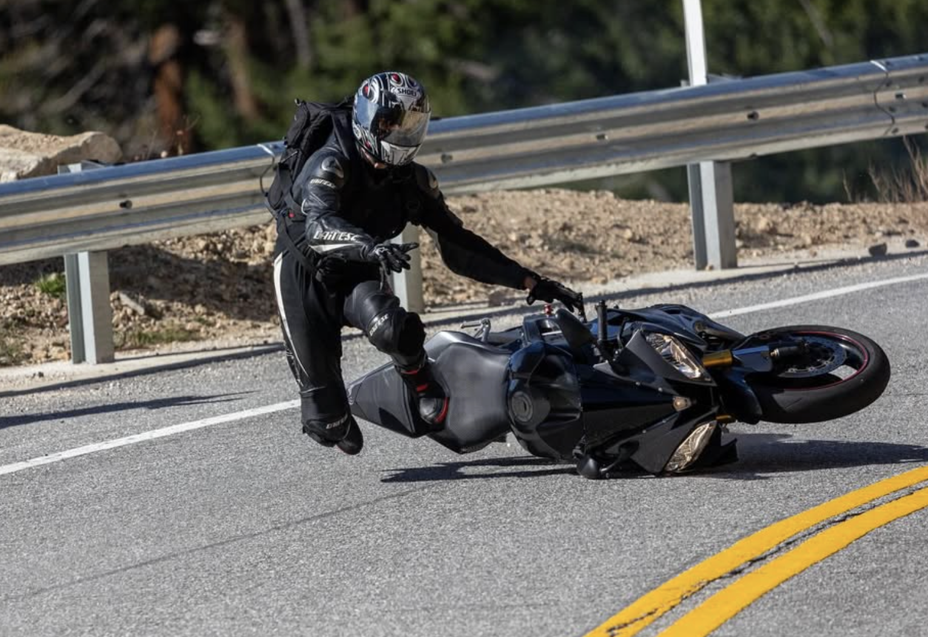
Predicting Motorcycle Injury Severity Using Southern California Crash Data
National University
Department of Technology & Engineering
ANA699A Capstone Project I
January 27, 2026
Dr. Mario Missakian
Presenters: Ed Baek, Amber Garcia, Ryan Neighbor, Jeremiah Snipes
(Project 65 Studios, 2024)

Slide 2














This proposal is organized from research questions and prior literature through data sources, modeling, evaluation and validation, and limitations and conclusion.
Research Questions
& Literature Review
Dataset
Data Preparation
Limitations &
Conclusions
Evaluation &
Validation
Modeling

Slide 3
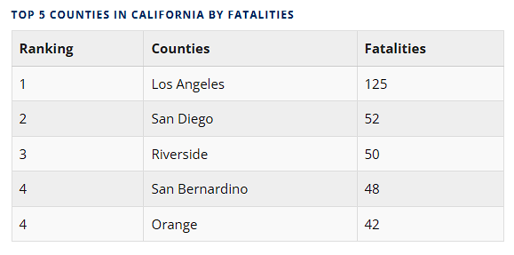
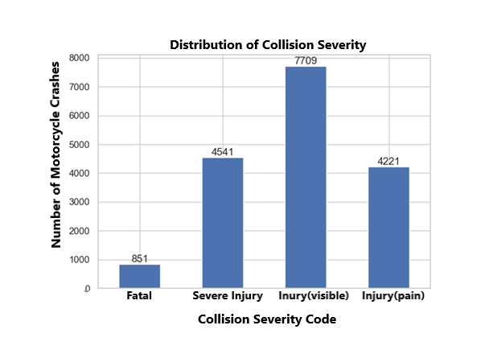
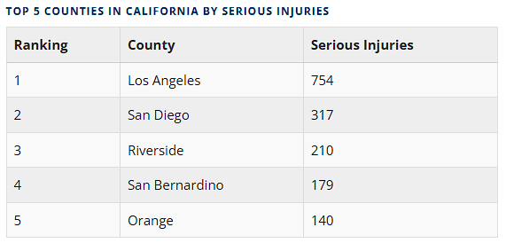
Motorcycle crashes in California produce disproportionately fatal and severe injuries, making severity prediction a public safety concern.
(TIMS, 2025)
(Safe Transportation Research and Education Center, 2025)

Slide 4
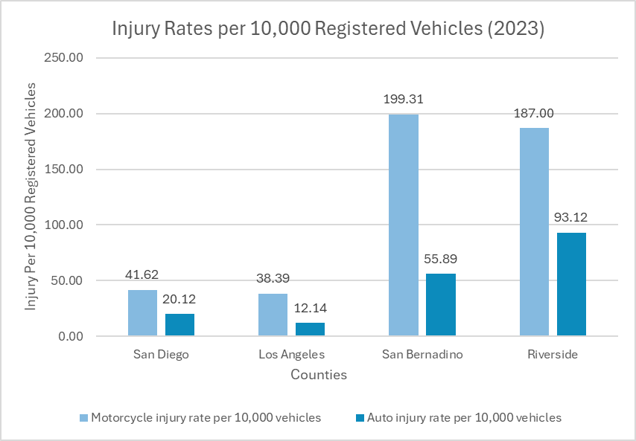
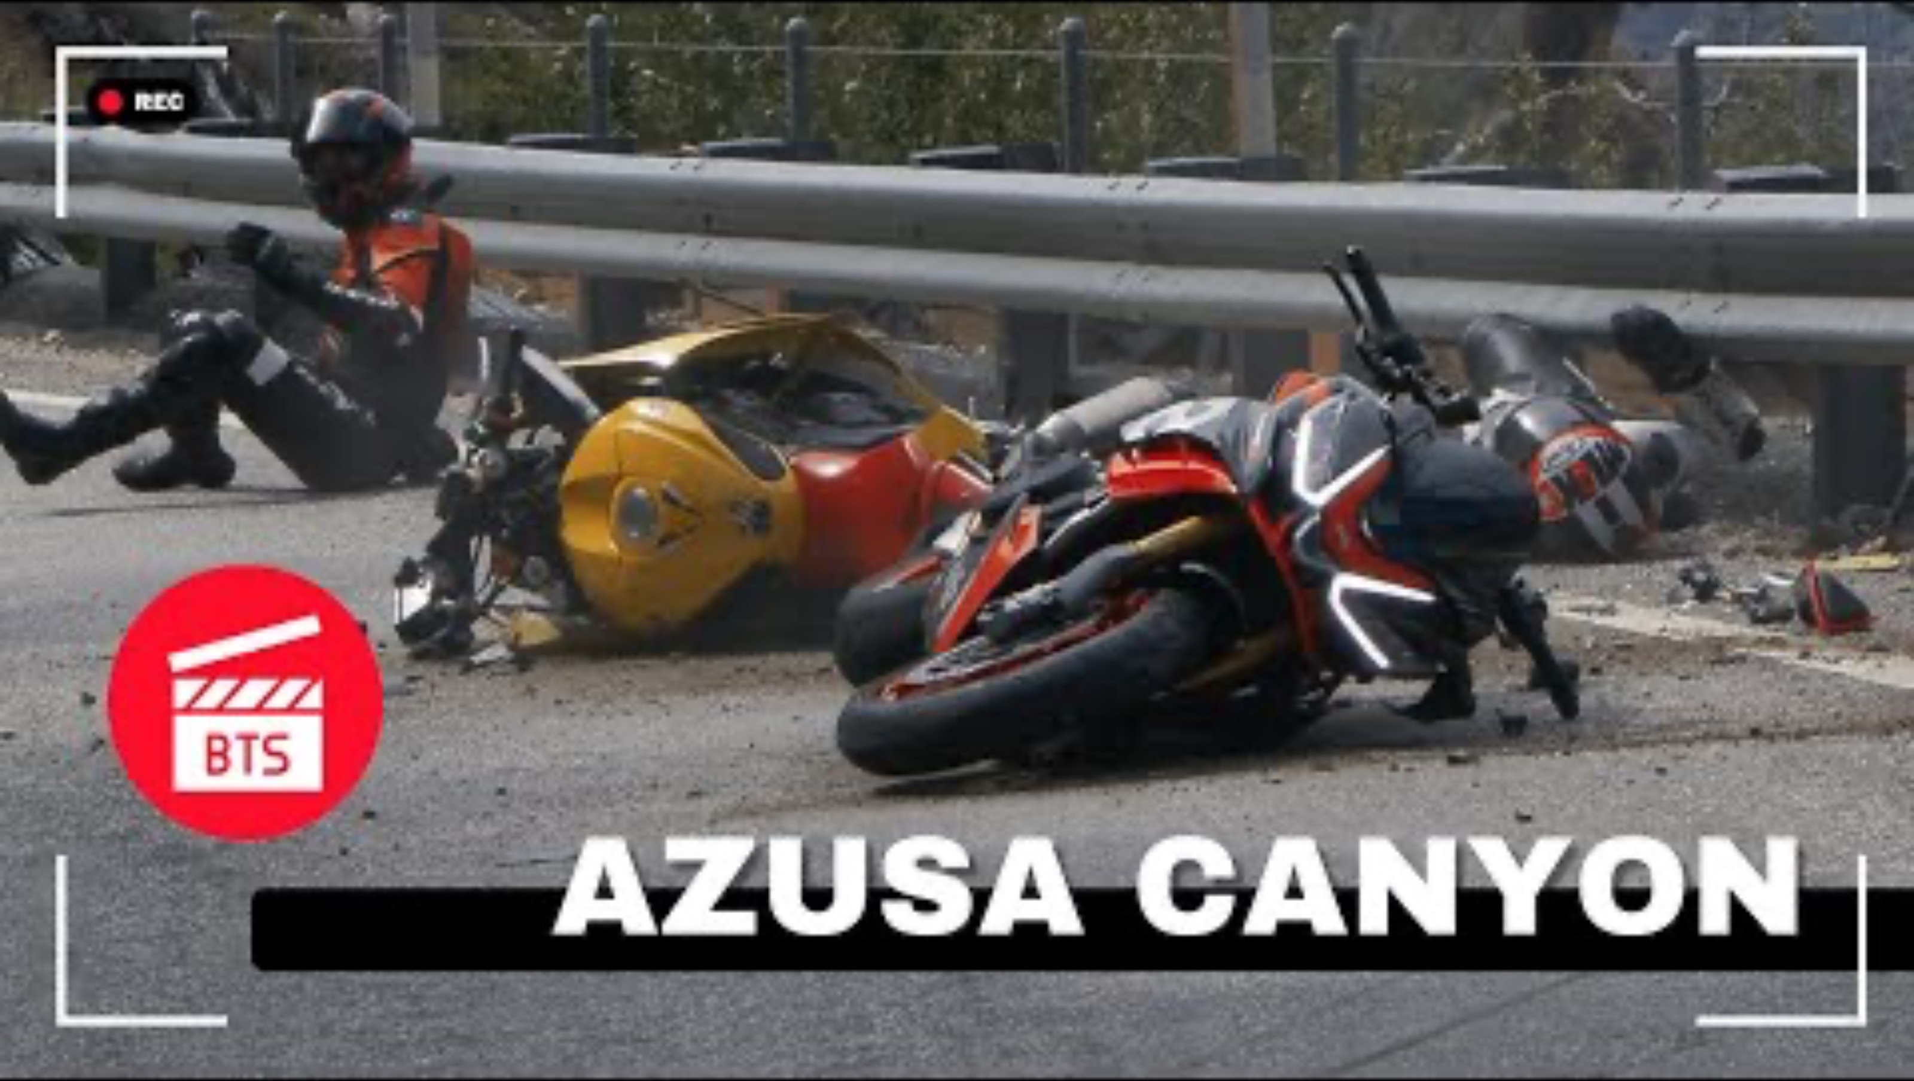
Prior literature and local evidence demonstrate disproportionate motorcycle injury risk
Motorcyclists face 24-28x higher fatality risk per mile traveled.
(California OTS & DMV, 2023)
(Project 65 Studios, 2024)

Slide 5
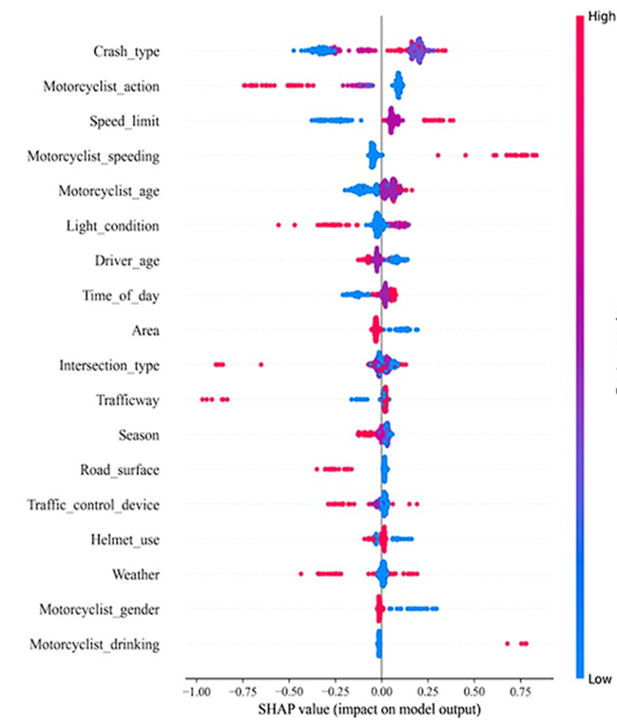
Prior literature shows that motorcycle injury severity is driven by interacting behavioral, human, environmental, and vehicle factors
SHAP values show the direction and magnitude of each variable’s contribution to injury severity predictions.
Behavioral Factors
Vehicle Factors
Environmental Factors
Human Factors
Literature Review: Prior findings on Motorcycle Injury Severity

Slide 6
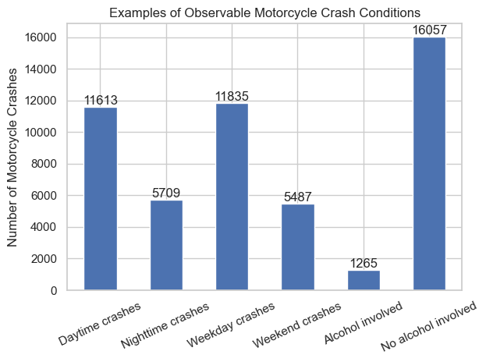
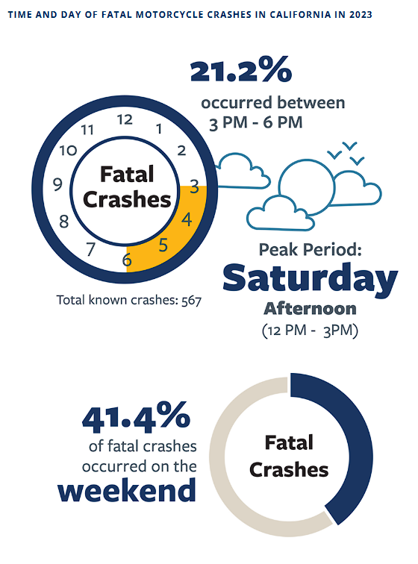
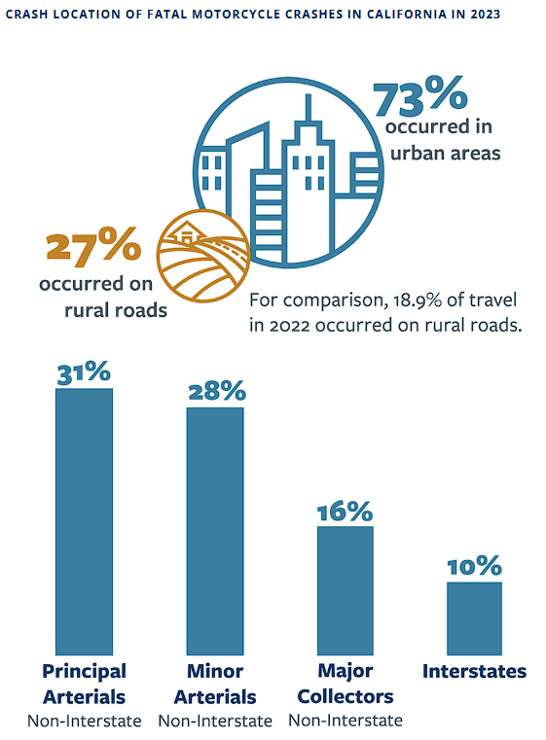
Two research questions about predicting motorcycle injury severity using southern California crash data.
Q1. Which behavioral, human, environmental, and vehicle factors are associated with severe motorcycle injury outcomes in Southern California crashes?
Q2. How does the relationship between these factors and injury severity vary across roadway and temporal conditions?
(TIMS, 2025)
(Safe Transportation Research and Education Center, 2025)

Slide 7


Data will be drawn from two sources and integrated to support predicting motorcycle injury severity.
Transportation Injury Mapping System (TIMS)
California DMV County Motorcycle Registrations
Los Angeles County
Crash Data
San Diego County
Crash Data
Riverside
County
Crash Data
San Bernardino
County
Crash Data
Los Angeles County Motorcycle Registrations
San Diego County Motorcycle Registrations
Riverside County Motorcycle Registrations
San Bernardino County Motorcycle Registrations
Complete Dataset

Slide 8
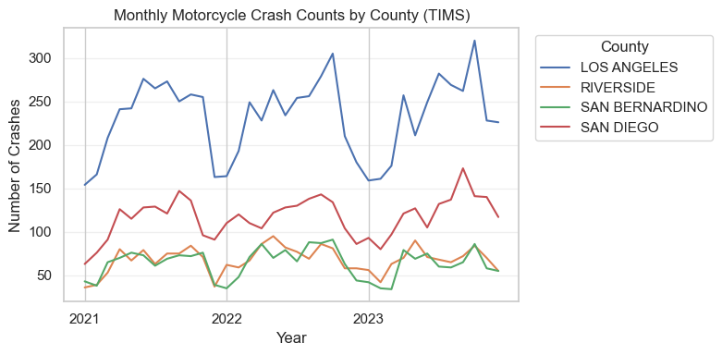
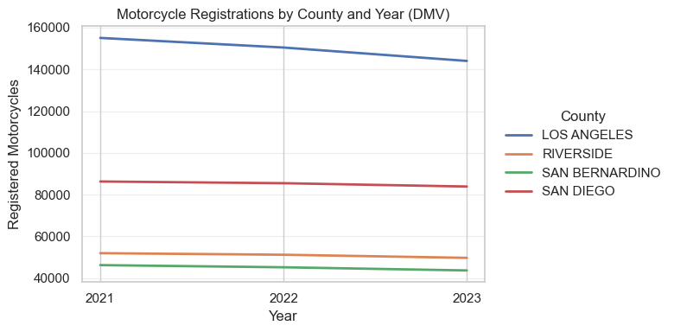
Crash records are analyzed alongside county-level motorcycle registration totals to provide exposure context.
Total motorcycle crashes (2021–2023): 17,322
Average registered motorcycles per year: 330,980
(TIMS, 2025)
(Safe Transportation Research and Education Center, 2025)
Notes:
“This slide shows that our 17,322 crash records are analyzed in the context of how many motorcycles are actually registered in each county, preventing raw count misinterpretation

Slide 9
This slide defines what we’re predicting and the categories of information we use to explain differences in injury severity.
Outcome (Dependent Variable)
Predictor Groups (Independent Variables)
Injury Severity KABCO
Fatal
Severe Injury
Other Injury
Possible Injury
Rider Behavior
Alcohol involvement
Speed-related indicator
Unsafe driving action
Roadway & environment
Roadway type
Lighting condition
Intersection vs non-intersection
Time & crash context
Time of day
Day of week
Collision type
Number of vehicles involved
(TIMS, 2025)
(Safe Transportation Research and Education Center, 2025)

Slide 10
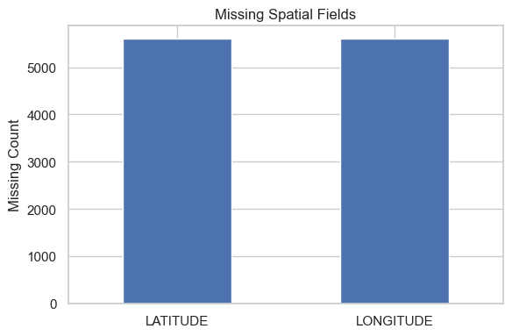
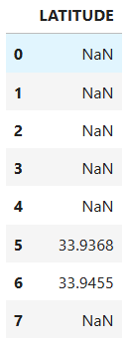
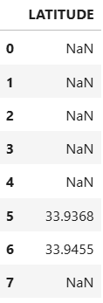
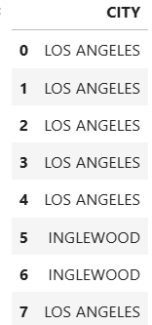
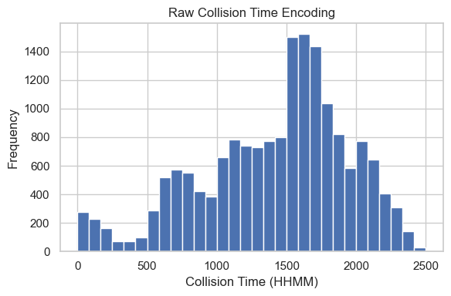
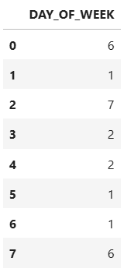
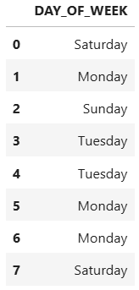
Raw TIMS crash records require structured transformation before modeling.
Data Preparation
Data Cleaning
Before
After
(TIMS, 2025)
(Safe Transportation Research and Education Center, 2025)

Slide 11
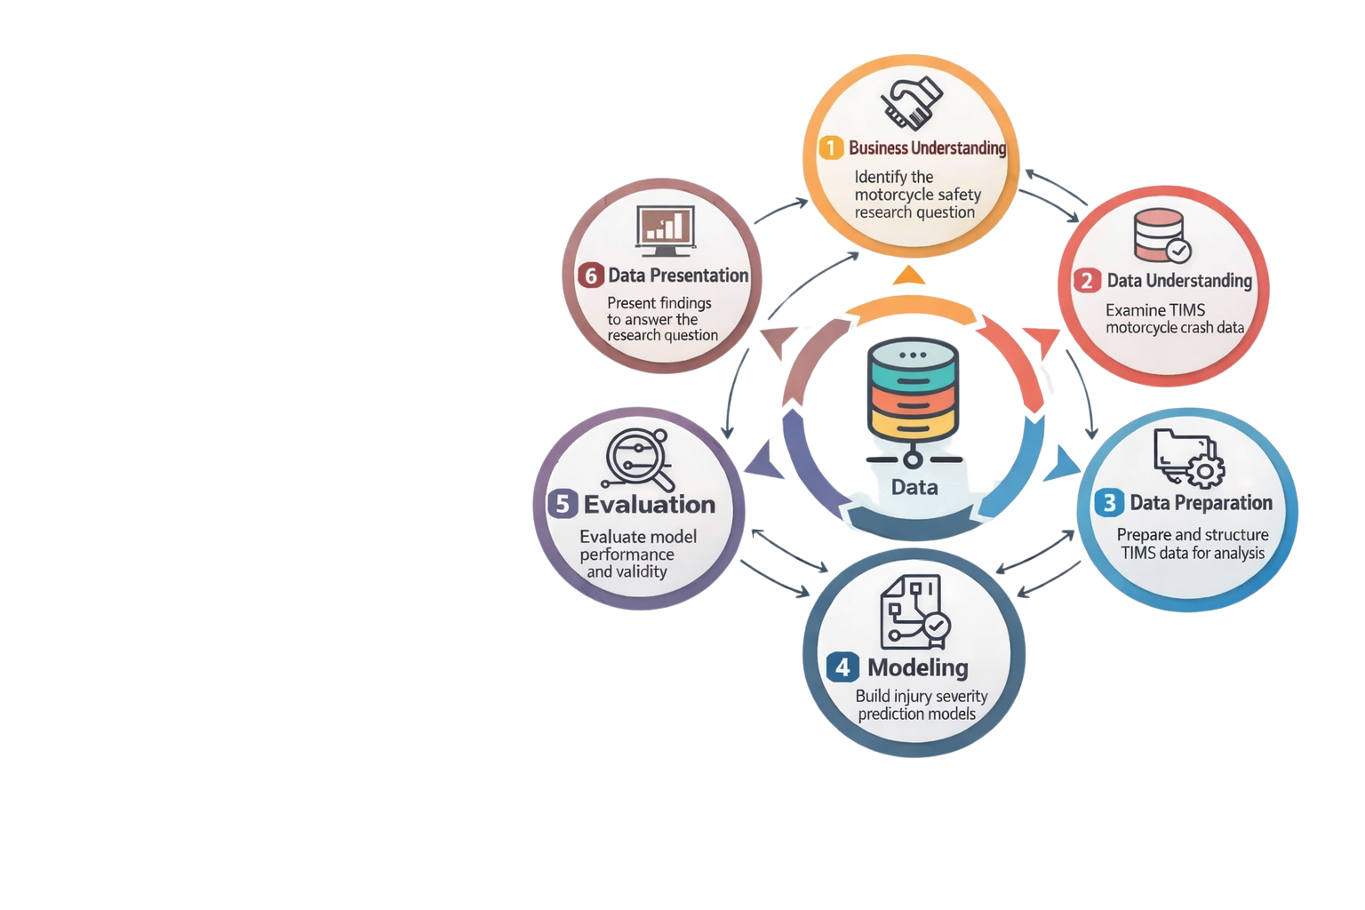


A supervised injury severity classification model that estimates the risk of severe or fatal motorcycle injury given crash characteristics.
Supervised Injury Severity Risk Modeling
Train / Validation / Test Split
Logistic Regression
Random Forest
XGBoost
ROC-AUC | Precision | Recall
Compare model behavior

Slide 12
Modeling
(TIMS, 2025)
(Safe Transportation Research and Education Center, 2025)

Slide 13
Evaluation &
Validation
(TIMS, 2025)
(Safe Transportation Research and Education Center, 2025)

Slide 14
Evaluation &
Validation
(TIMS, 2025)
(Safe Transportation Research and Education Center, 2025)

Slide 15
Limitations &
Conclusions
(TIMS, 2025)
(Safe Transportation Research and Education Center, 2025)

Slide 16
Limitations &
Conclusions
(TIMS, 2025)
(Safe Transportation Research and Education Center, 2025)

Slide 17
References
Chapman, P., Clinton, J., Kerber, R., Khabaza, T., Reinartz, T., Shearer, C., & Wirth, R. (2000). CRISP-DM 1.0: Step-by-step data mining guide. CRISP-DM Consortium.
Federal Highway Administration. (2019). Motorcycle crash causation study: Final report (FHWA-HRT-18-064). U.S. Department of Transportation. https://highways.dot.gov/sites/fhwa.dot.gov/files/FHWA-HRT-18-064.pdf
Federal Highway Administration. (2019). Motorcycle crash causation study: Volume 1—Data collection and variable naming (FHWA-HRT-18-040). U.S. Department of Transportation. https://highways.dot.gov/sites/fhwa.dot.gov/files/FHWA-HRT-18-040_0.pdf
Hsu, T.-P., & Wen, K.-L. (2022). Using multinomial regression to explore the spatial factors affecting left-turn oncoming accidents involving motorcycles. Traffic Injury Prevention, 23(1), 46–50. https://doi.org/10.1080/15389588.2021.2009115
Investigating determinants of injury severity in motorcycle–vehicle crashes using interpretable machine learning models. (2025). Journal of Safety Research. https://www.sciencedirect.com/science/article/abs/pii/S1538958825001985
OpenAI. (2025). ChatGPT. https://chat.openai.com/
Project65Studios. (2024). Motorcycle crash scene, Southern California [Photograph]. Instagram. https://www.instagram.com/p/C2x_XqFyJFa1pa90_qfQjJP1f8KWhcoMImumBk0/
Safe Transportation Research and Education Center. (2025). 2025 SafeTREC traffic safety facts: Motorcycle safety. University of California, Berkeley. https://safetrec.berkeley.edu/2025-safetrec-traffic-safety-facts-motorcycle-safety
State of California Department of Motor Vehicles. (n.d.). Vehicles registered by county. https://www.dmv.ca.gov/portal/dmv-research-reports/research-development-data-dashboards/vehicles-registered-by-county/
State of California Office of Traffic Safety. (2023). OTS crash rankings. https://www.ots.ca.gov/media-and-research/crash-rankings/
Statewide Integrated Traffic Records System (TIMS). (2025). Traffic collision data and mapping tools. California Department of Transportation. https://tims.berkeley.edu
Wei, T., Zhu, T., Lin, M., & Liu, H. (2025). Predicting and factor analysis of rider injury severity in two-wheeled motorcycle and vehicle crash accidents based on an interpretable machine learning framework. Traffic Injury Prevention, 25(2), 194–201. https://doi.org/10.1080/15389588.2023.2284111

